Slide 1
Accessing the curriculum for diverse Learners
Contemporary Functional Life Skills cont’d

Slide 2
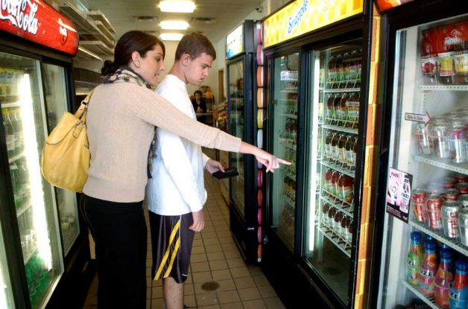
Skills that are functional
Skills | Classroom or school | Community | Home
Greeting people

Slide 3

Transition Planning
Youth with special needs as defined by BC Ministry of Education
Between the ages of 14-25
2008, inter-ministerial protocol and framework

Slide 4
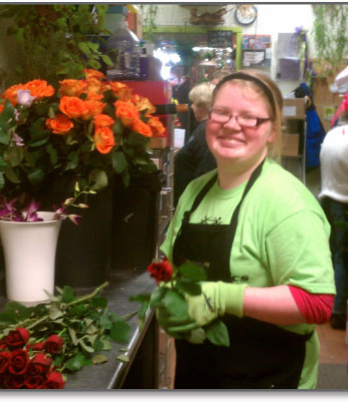
Transition Planning
Youth-centred
Family-focused
Holistic
Strengths-based
Cultural identity
Supports for having youth live as fully and independently as possible
Supports youth’s lifelong wellness and participation and inclusion in their communities
Evidence based

Slide 5
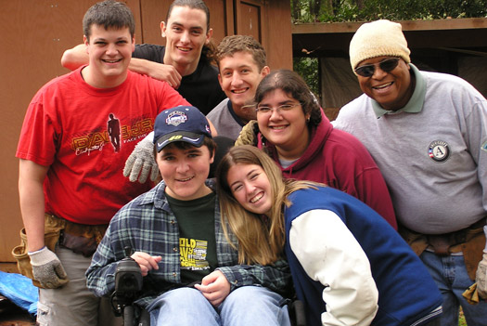
Transition planning
Comprehensive and integrated across service sectors
Innovative and flexible
Sustainable
Accountable to youth, their families and others involved
Aligned with Jordan’s principle

Slide 6
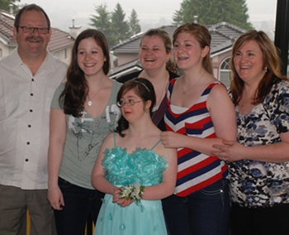
Video project: On my way

Slide 7

Transition Planning
Issues?

